Slide 1
XAI
Visual Analytics for explainable Deep Learning

Slide 2
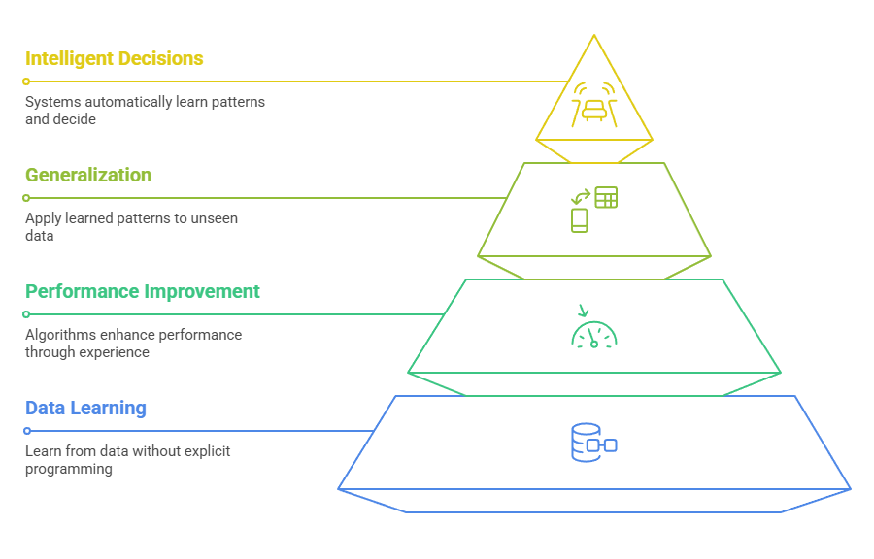
Machine Learning
Learn from data without explicit programming

Slide 3
Machine Learning
Learn from data without explicit programming
ML algorithms improve performance through experience

Slide 4
Machine Learning
Learn from data without explicit programming
ML algorithms improve performance through experience
  Learn from data and generalize to unseen data

Slide 5
Machine Learning
Learn from data without explicit programming
ML algorithms improve performance through experience
  Learn from data and generalize to unseen data
Key goal: Create systems that can automatically learn patterns and make intelligent decisions

Slide 6
Types of Machine Learning
Supervised Learning: Learns from labelled training data
  Examples: Classification, Regression
  Used in spam detection, price prediction
Unsupervised Learning: Finds patterns in unlabelled data
  Examples: Clustering, Dimensionality Reduction
  Used in customer segmentation, anomaly detection
Reinforcement Learning: Learns through trial and error
  Used in game AI, robotics, autonomous systems

Slide 7
Deep Learning
Advanced machine learning technique using multi-layered neural networks
Mimics human brain's neural structure to process complex data
Enables automatic feature extraction and learning from raw data

Slide 8
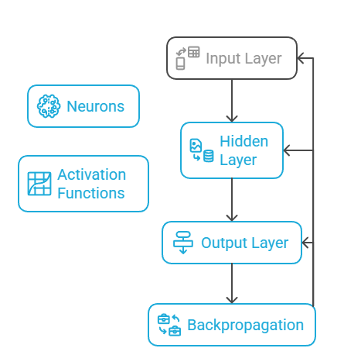
Neural Network Architecture
Layers: Input, Hidden, Output layers

Slide 9
Neural Network Architecture
Layers: Input, Hidden, Output layers
Neurons: Process and transmit information

Slide 10
Neural Network Architecture
Layers: Input, Hidden, Output layers
Neurons: Process and transmit information
Activation Functions: Introduce non-linearity

Slide 11
Neural Network Architecture
Layers: Input, Hidden, Output layers
Neurons: Process and transmit information
Activation Functions: Introduce non-linearity
Backpropagation: Learns by adjusting network weights

Slide 12
Various Deep Learning Techniques

Slide 13
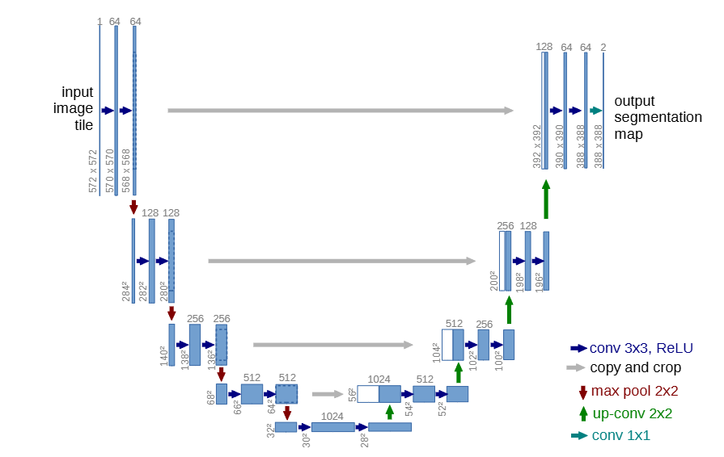
Various Deep Learning Techniques
Convolutional Neural Networks (CNNs)
  Image and video processing
  Pattern recognition
U-Net: Convolutional Networks for Biomedical Image Segmentation, https://doi.org/10.48550/arXiv.1505.04597

Slide 14
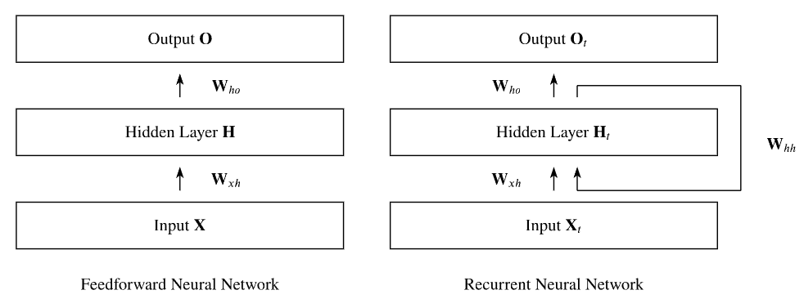
Various Deep Learning Techniques
Recurrent Neural Networks (RNNs)
  Sequential data analysis
  Natural language processing
Recurrent Neural Networks (RNNs):A gentle Introduction and Overview, https://doi.org/10.48550/arXiv.1912.05911

Slide 15
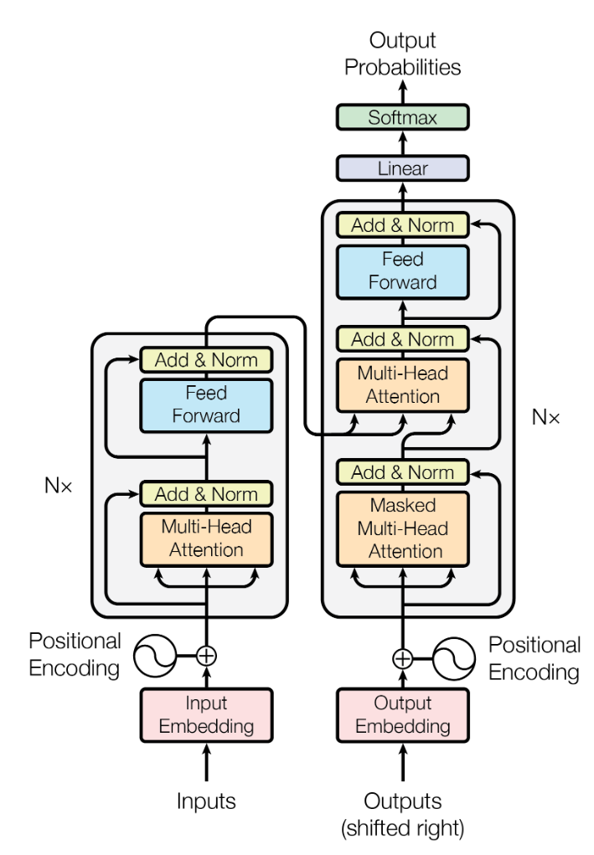
Various Deep Learning Techniques
Transformers
  Advanced language models
  Context understanding
Attention Is All You Need, https://doi.org/10.48550/arXiv.1706.03762

Slide 16
Training Deep Learning Models
Large datasets critical for performance
Requires significant computational power
Techniques: Transfer Learning, Data Augmentation
Challenges: Overfitting, Computational Complexity

Slide 17
Why We Need Explainable AI
It is difficult to trust a system whose decisions we don't understand.
Lack of transparency can lead to bias and unfair outcomes.
Explainability is essential for accountability and regulation of AI.

Slide 18
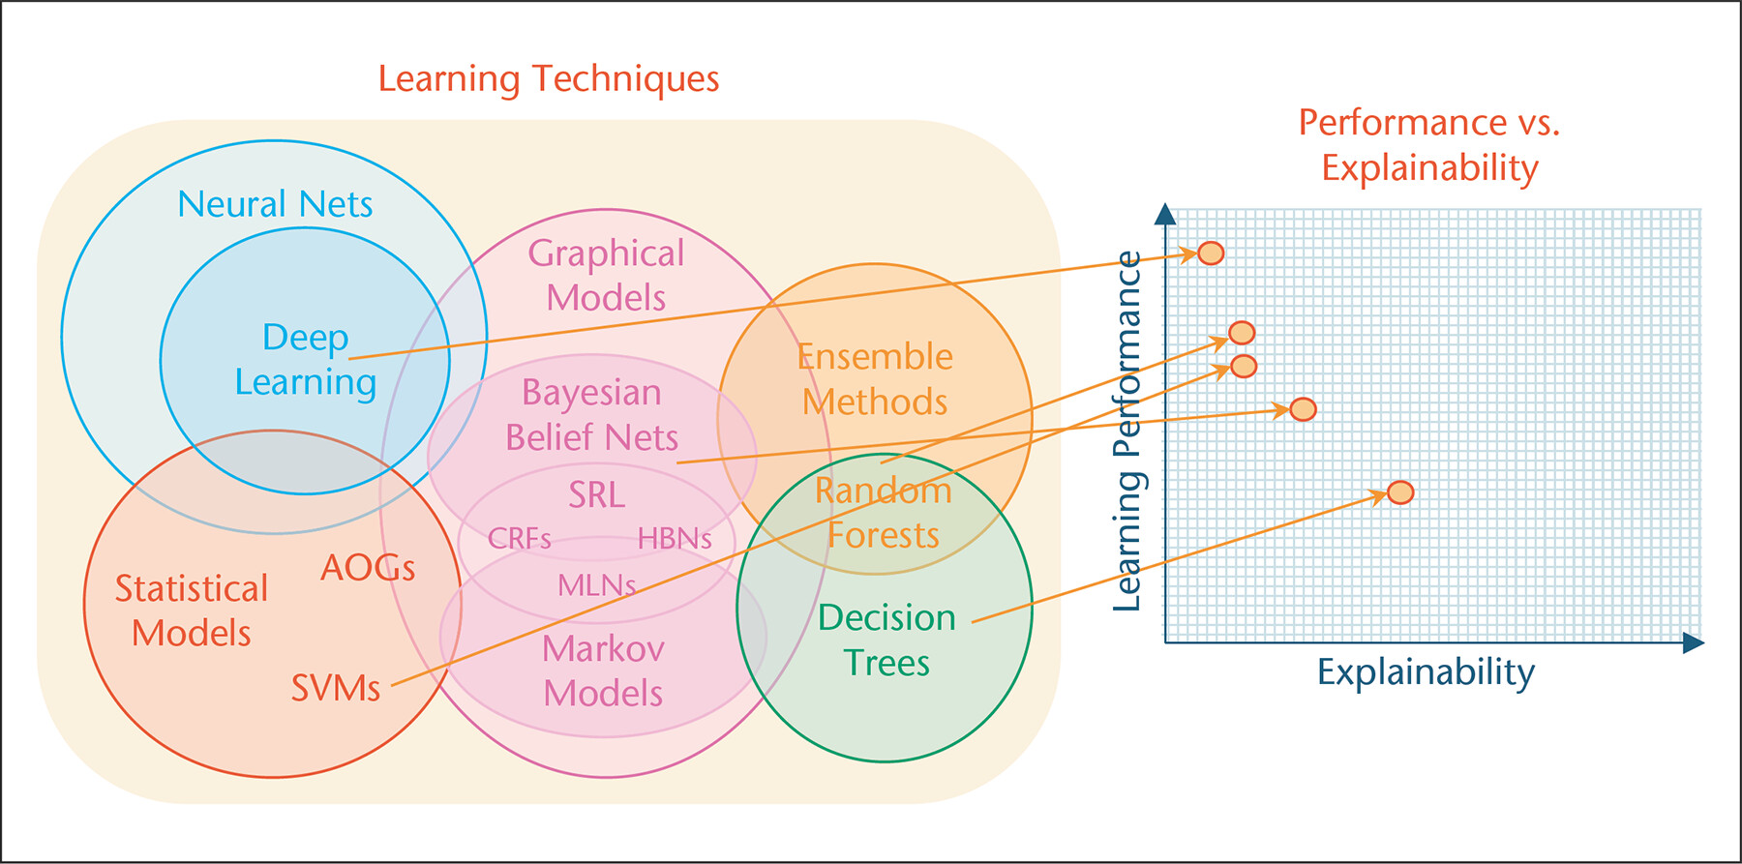
Learning Performance vs. Explainability
[Gunning]

Slide 19
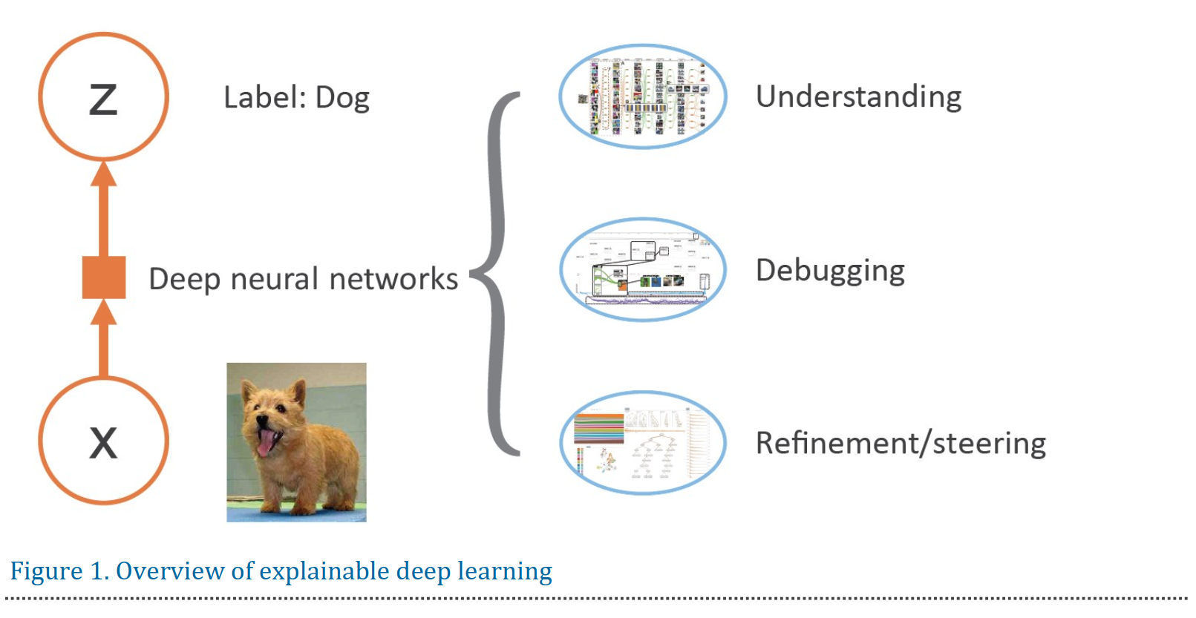
Overview
[Choo]

Slide 20
Definitions
XAI aims to develop machine learning techniques that provide understandable, trustworthy and explainable rationales for decisions made by black-box models. [Adadi, Dragoni, Gunning]
XAI is the class of systems that provide visibility into how an AI system makes decisions and predictions and executes its actions. [Rai]
XAI refers to systems that try to explain how a black-box AI model produces its outcomes. [Moradi]

Slide 21
Definitions
XAI aims to develop machine learning techniques that provide understandable, trustworthy and explainable rationales for decisions made by black-box models. [Adadi, Dragoni, Gunning]
XAI is the class of systems that provide visibility into how an AI system makes decisions and predictions and executes its actions. [Rai]
XAI refers to systems that try to explain how a black-box AI model produces its outcomes. [Moradi]
-> Explain how Black-Box-Models get to their decisions

Slide 22
What is XAI
XAI refers to techniques that make AI systems more understandable to humans.
It aims to provide insights into how AI systems make decisions and why they reach conclusions.

Slide 23
Stakeholders / Who needs XAI?
Data scientists use XAI to debug and improve models.
Domain experts need to understand the reasoning behind AI's recommendations.
End users deserve to know how AI affects their lives.
Regulators need audit trails and compliance evidence

Slide 24
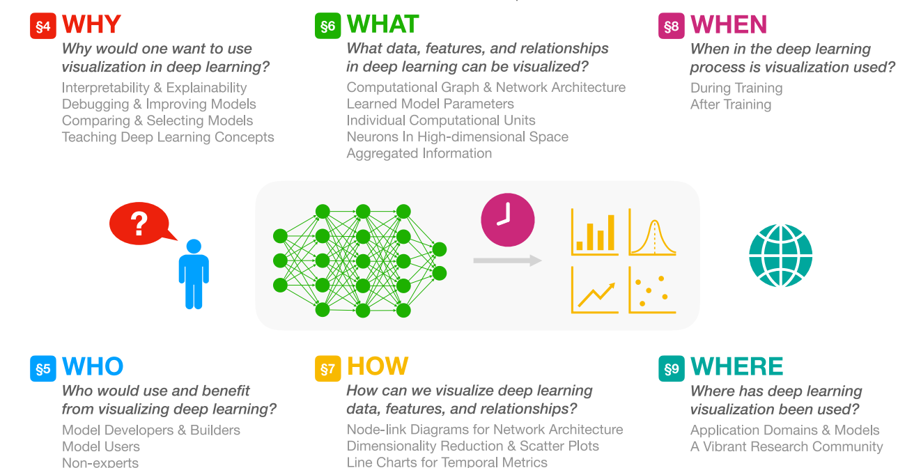
Important Questions
[Homann]

Slide 25
Important Questions
[Homann]

Slide 26
Important Questions
[Homann]

Slide 27
Overview – Visual Analytics for Machine Learning
[Yuan]

Slide 28
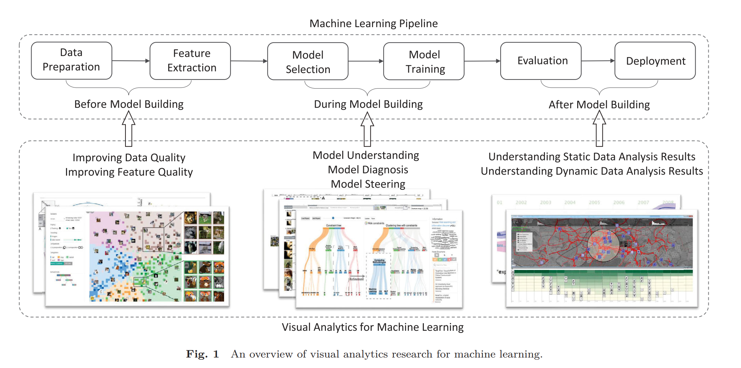
Overview – Visual Analytics for Machine Learning
[Yuan]

Slide 29
Overview – Visual Analytics for Machine Learning
[Yuan]

Slide 30
Overview – Visual Analytics for Machine Learning
[Yuan]

Slide 31
Overview – Visual Analytics for Machine Learning
[Yuan]

Slide 32
Overview – Visual Analytics for Machine Learning
[Yuan]

Slide 33
Overview – Visual Analytics for Machine Learning
[Yuan]

Slide 34
Overview – Visual Analytics for Machine Learning
[Yuan]

Slide 35
Overview – Visual Analytics for Machine Learning
[Yuan]

Slide 36
Overview – Visual Analytics for Machine Learning
[Yuan]

Slide 37
Overview – Visual Analytics for Machine Learning
[Yuan]

Slide 38
Overview – Visual Analytics for Machine Learning
[Yuan]

Slide 39
Overview – Visual Analytics for Machine Learning
[Yuan]

Slide 40
Overview – Visual Analytics for Machine Learning
[Yuan]

Slide 41
Overview
[Yuan]

Slide 42
Techniques Before Model Building
Ensure high-quality data and features to improve model performance and reliability.
Improving Data Quality
Improving Feature Quality

Slide 43
Improving Data Quality - Instance-Level
Anomaly Detection and Correction:
  Visualising and interacting with data to identify missing values,
  outliers,
  duplicates,
  and out-of-distribution samples.
  i.e. Profiler and OoDAnalyzer
Provenance Tracking:
  Illustrating the impact of data cleaning and preprocessing steps on data quality.
  i.e. DQProv Explorer
Privacy Preservation:
  Balancing data utility with privacy concerns during the cleaning process
  i.e. Privacy Exposure Risk Tree and GraphProtector.

Slide 44
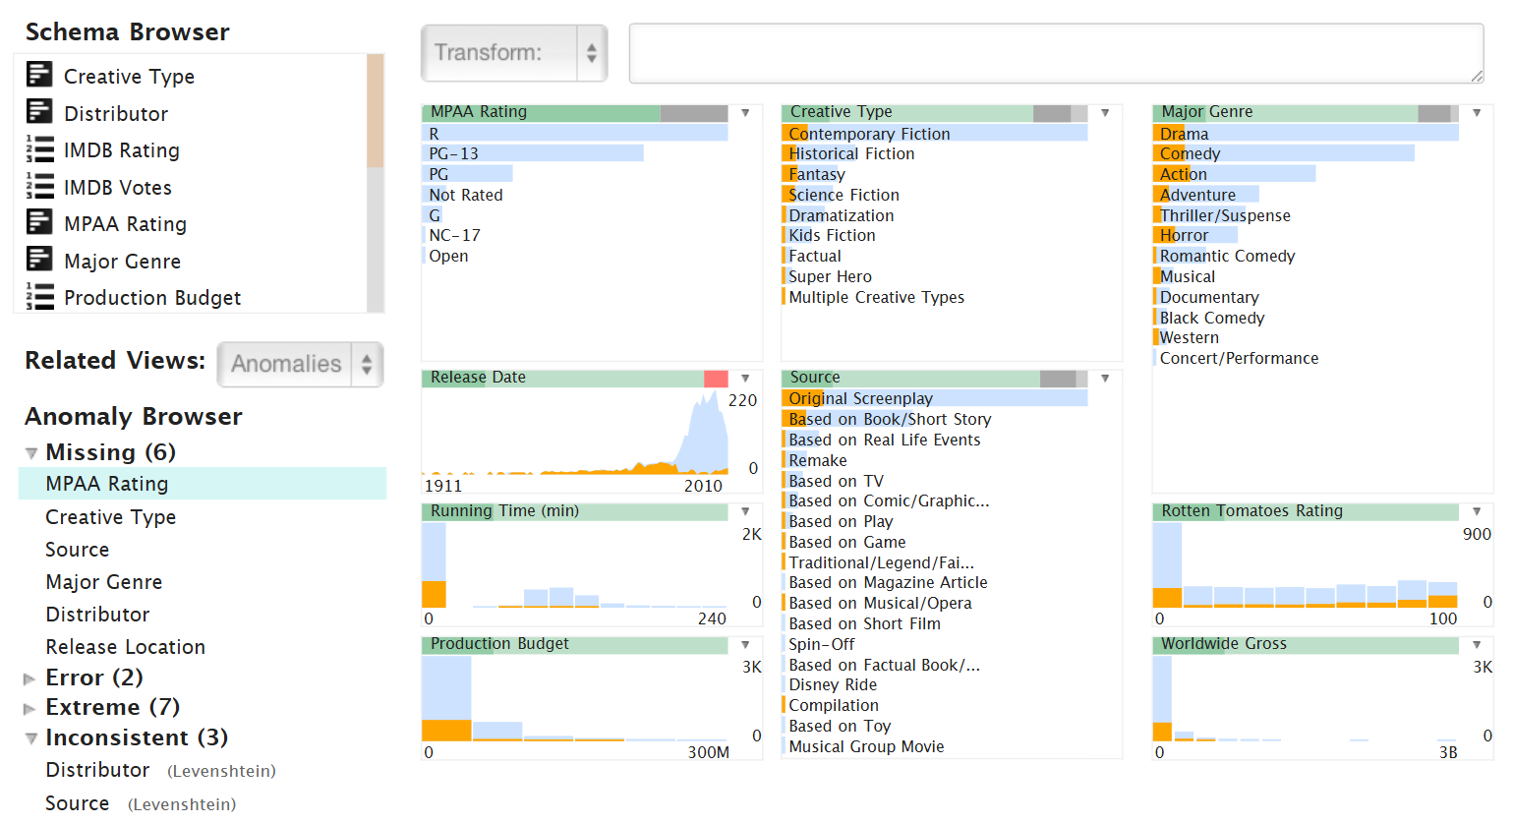
Improving Data Quality - Instance-Level
Anomaly Detection and Correction Example: Profiler
Profiler: integrated statistical analysis and visualization for data quality assessment, https://doi.org/10.1145/2254556.2254659

Slide 46
Improving Data Quality - Label-Level
Noisy Label Handling:
  Visualising and refining crowdsourced annotations,
  identifying unreliable workers,
  correcting mislabelled instances.
  i.e. LabelInspect and C2A
Interactive Labelling:
  Efficiently labelling unlabelled data by leveraging techniques like clustering similar instances and filtering to find items of interest.
  i.e. MediaTable and the SOM-based visualisation by Moehrmann et al..

Slide 47
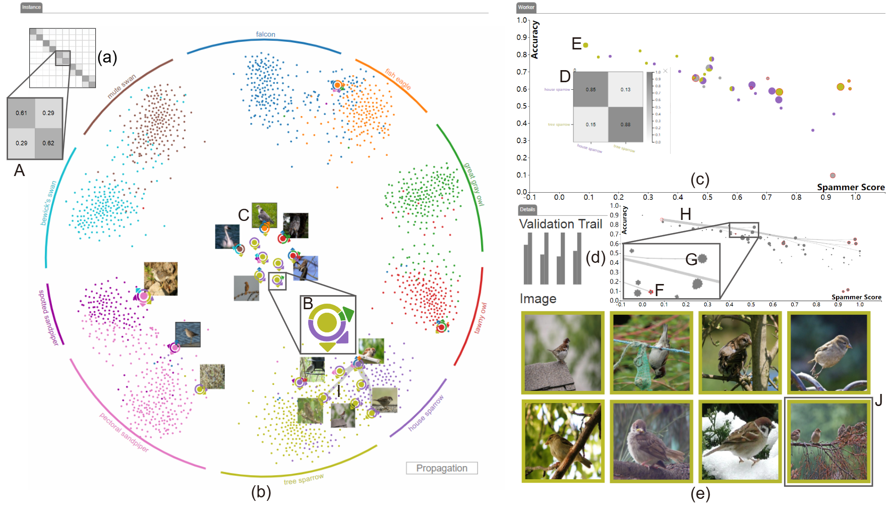
Improving Data Quality - Label-Level
Noisy Label Handling Example: LabelInspect
An Interactive Method to Improve Crowdsourced Annotations, doi: 10.1109/TVCG.2018.2864843.

Slide 49
Improving Feature Quality
Feature Selection:
  Select useful features that contribute most to the prediction.
  i.e. DimStiller and SmartStripes
Feature Construction:
  Guide the creation of new, more discriminative features.
  i.e. FeatureInsight

Slide 50
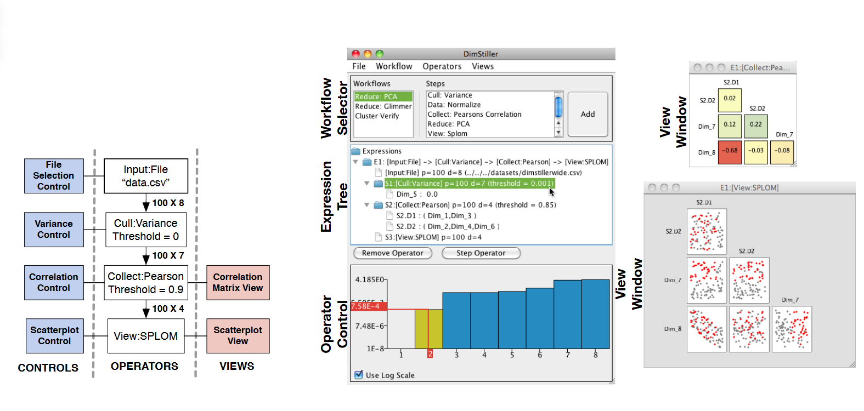
Improving Feature Quality
Feature Selection Example: DimStiller
DimStiller: Workflows for Dimensional Analysis and Reduction, doi: 10.1109/VAST.2010.5652392.

Slide 51


Slide 52
Overview – Visual Analytics for Machine Learning
[Yuan]

Slide 53
Techniques During Model Building
Gain deeper understanding of model workings, diagnose training issues, and steer model behaviour towards desired outcomes.
Model Understanding
Model Diagnosis
Model Steering

Slide 54
Model Understanding - Parameter Effects
Understanding Parameter Effects:
  Visualising how model outputs change with variations in parameter settings.
  i.e. BirdVis

Slide 55
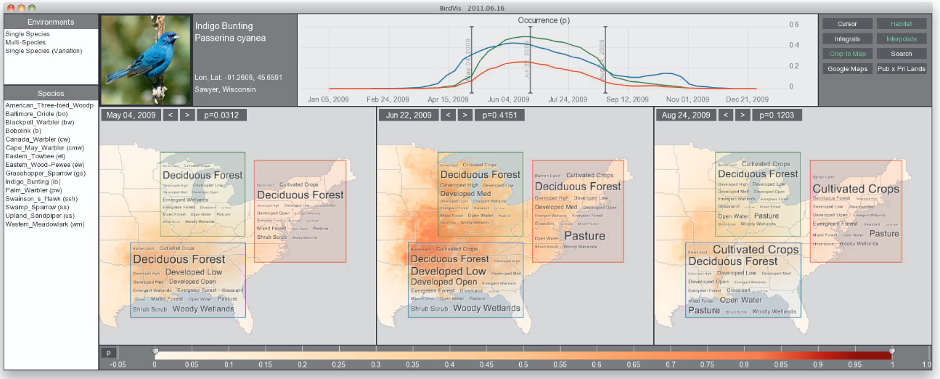
Model Understanding - Parameter Effects
Understanding Parameter Effects Example: BirdVis
BirdVis: Visualizing and Understanding Bird Populations, doi: 10.1109/TVCG.2011.176.

Slide 56


Slide 57
Model Understanding - Model Behaviours
Network-Centric Methods:
  Exploring model structure,
  visualising neuron activations,
  and interpreting how different parts of the model contribute to the final output.
  i.e. CNNVis for convolutional neural networks and LSTMVis for recurrent neural networks.
Instance-Centric Methods:
  Analysing individual instances and their relationships,
  visualising the representation space learned by the model.
  i.e. Rauber et al.
Hybrid Methods:
  Combining network-centric and instance-centric approaches
  i.e. Summit and ActiVis
Surrogate Model Explanations:
  Using simpler, interpretable models to explain the behaviour of more complex models.
  i.e. RuleMatrix and DeepVID

Slide 58
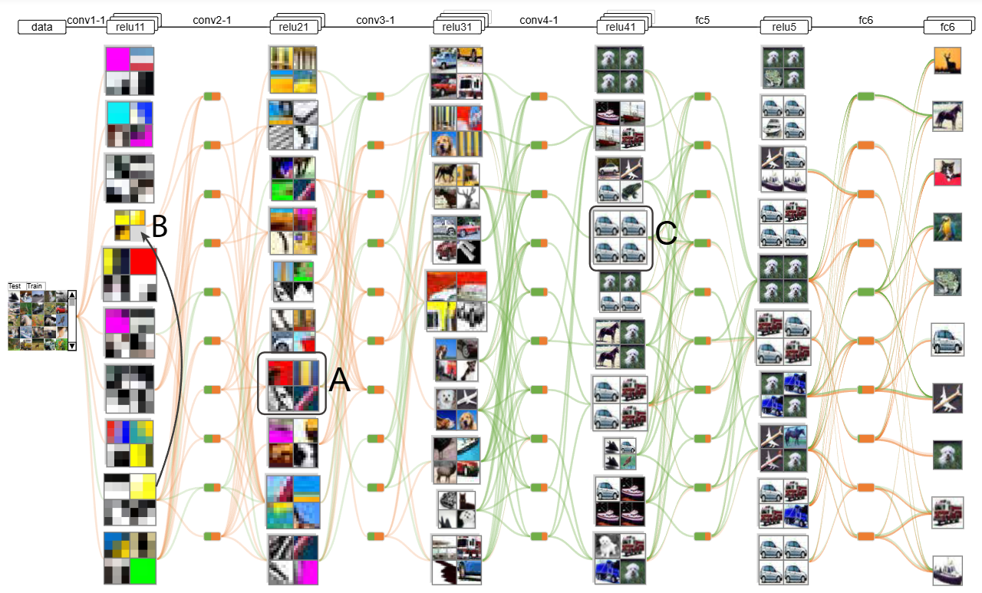
Model Understanding - Model Behaviours
Network-Centric Methods Example: CNNVis
Towards Better Analysis of Deep Convolutional Neural Networks, https://doi.org/10.48550/arXiv.1604.07043

Slide 59


Slide 60
Model Diagnosis
Analysing Training Results:
  Diagnose issues by visualising classifier performance,
  identifying fairness issues,
  exploring potential model vulnerabilities.
  i.e. Squares and FairSight
Analysing Training Dynamics:
  Monitor the training process,
  detecting anomalies,
  understand the evolution of model behaviour over time.
  i.e. DGMTracker and DQNViz

Slide 61
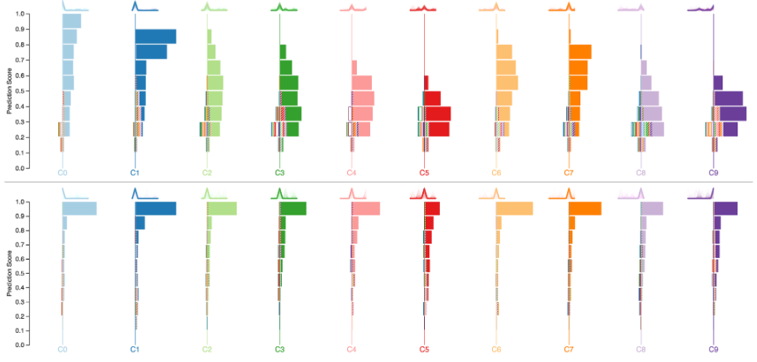
Model Diagnosis
Analysing Training Results: Squares
Squares: Supporting Interactive Performance Analysis for Multiclass Classifiers, doi: 10.1109/TVCG.2016.2598828

Slide 62
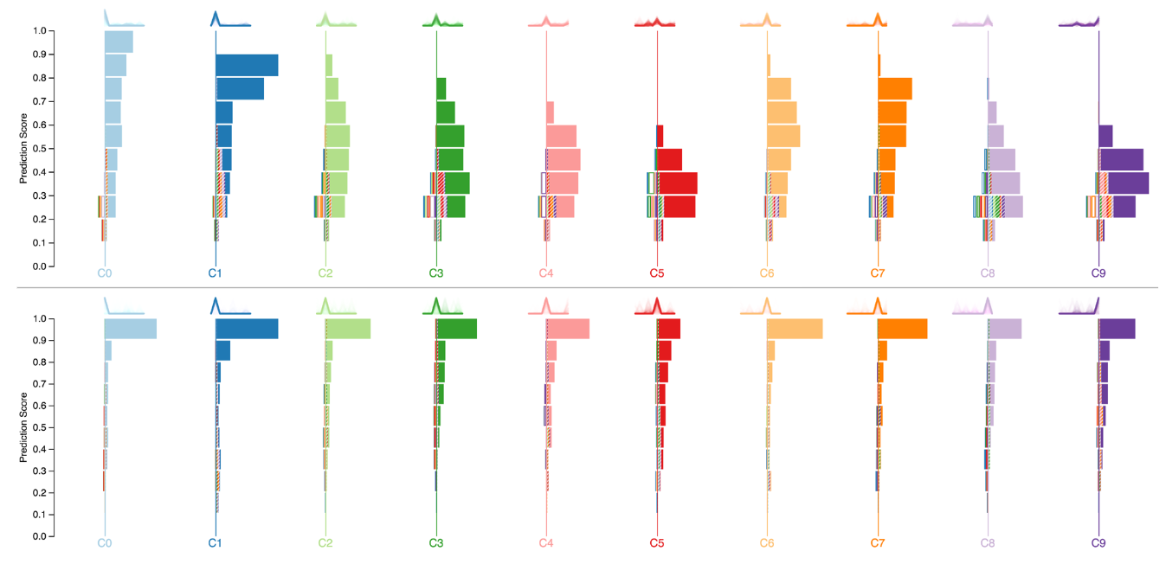

Slide 63
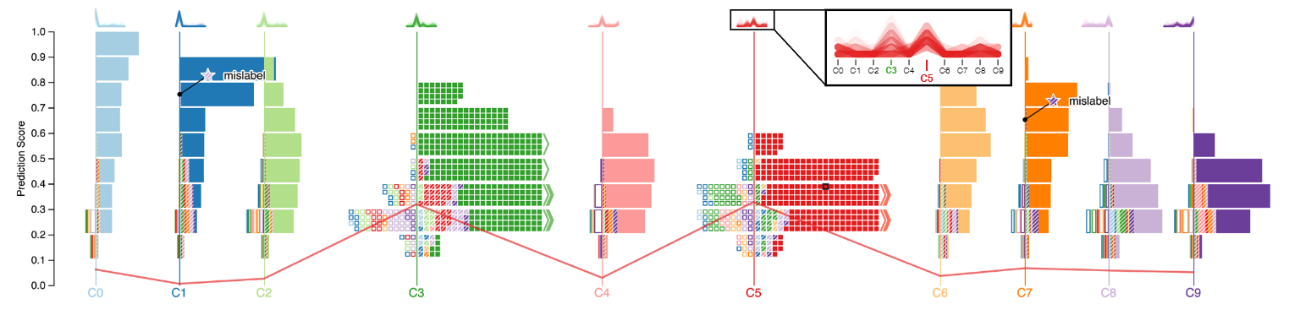

Slide 64
Model Steering
Model Refinement with Human Knowledge:
  Allowing users to interactively refine models by editing prototypes,
  adding constraints,
  correcting outputs.
  i.e. ProtoSteer and ReVision
Model Selection from Ensembles:
  Comparing and selecting the best model from a set of candidate models.
  i.e. BEAMES and RegressionExplorer

Slide 65
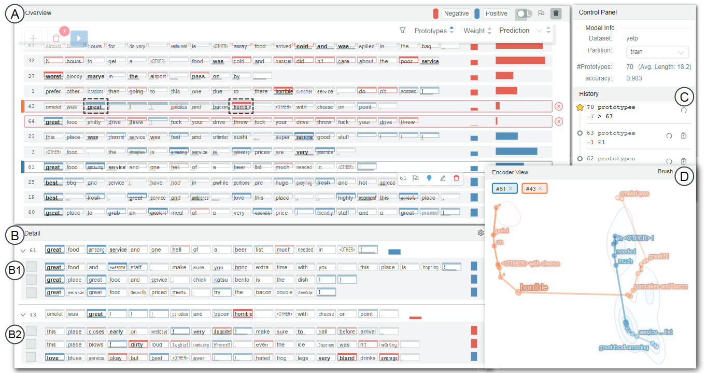
Model Steering
Model Refinement with Human Knowledge Example: ProtoSteer
ProtoSteer: Steering Deep Sequence Model with Prototypes, doi: 10.1109/TVCG.2019.2934267.

Slide 67
Overview – Visual Analytics for Machine Learning
[Yuan]

Slide 68
Techniques After Model Building
Help users make sense of model outputs, gain insights from data analysis results, and evaluate model performance in real-world contexts.
Understanding Static Data Analysis Results
Understanding Dynamic Data Analysis Results

Slide 69
Understanding Static Data Analysis Results
Textual Data Analysis:
  Visualizing topics, clusters, and relationships extracted from text data
  used techniques:
    topic modelling
    word embedding
  i.e. TopicPanorama , DemographicVis , and cite2vec.
Other Data Analysis:
  Extending visual analytics to other data types,
  E.g., flow fields and multi-dimensional data,
  used techniques:
    subspace analysis
    pattern matching
  i.e. SMARTexplore

Slide 70
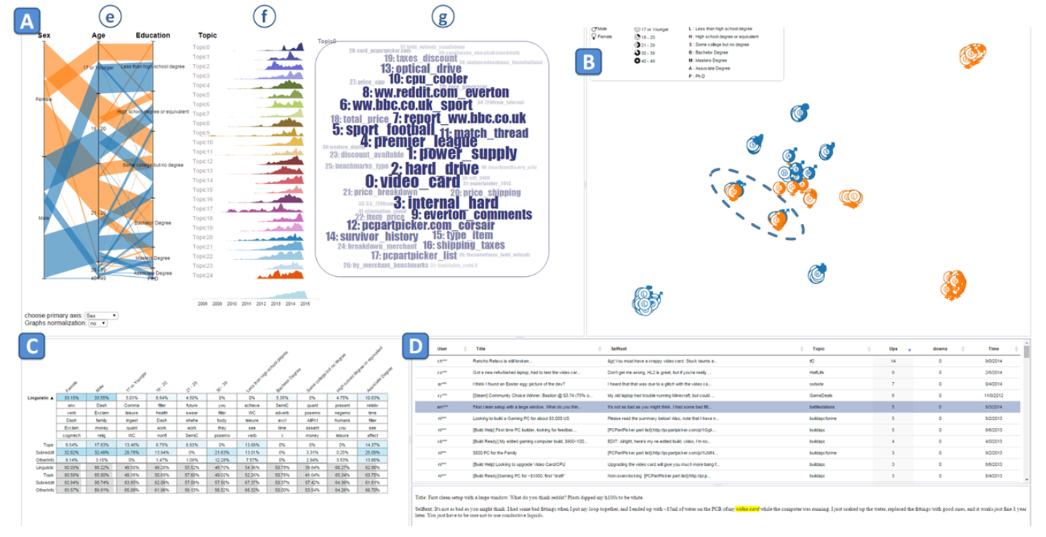
Understanding Static Data Analysis Results
Textual Data Analysis : DemographicVis
DemographicVis: Analyzing demographic information based on user generated content, doi: 10.1109/VAST.2015.7347631.

Slide 72
Understanding Dynamic Data Analysis Results
Offline Analysis: Exploring patterns and trends in data over time, with all data available before analysis.
  Topic Analysis: Visualizing topic evolution using techniques, which often employing a river metaphor to convey changes over time.
    i.e. ThemeRiver and TextFlow
  Event Analysis: Revealing important sequential patterns in event data, which leverage techniques like tensor decomposition and stage analysis.
    i.e. EventThread
  Trajectory Analysis: Visualizing and understanding movement patterns, often using techniques like clustering, pattern mining, and semantic enrichment.
    i.e. Kruger et al. and Chen et al. .

Slide 73
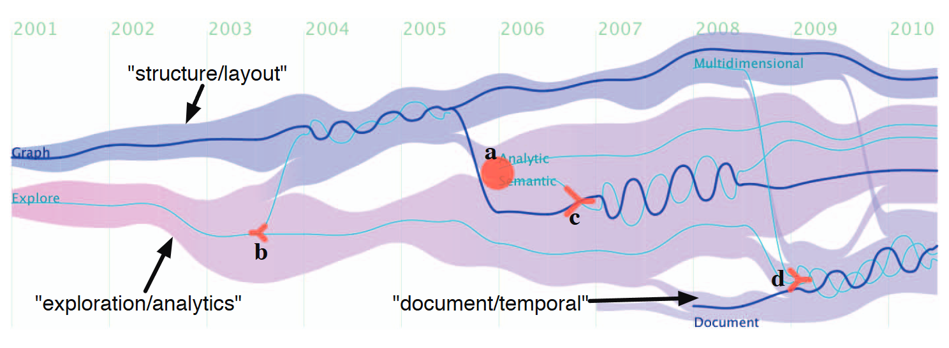
Understanding Dynamic Data Analysis Results
Offline Analysis Example: TextFlow
TextFlow: Towards Better Understanding of Evolving Topics in Text, doi: 10.1109/TVCG.2011.239.

Slide 75
Understanding Dynamic Data Analysis Results
Online Analysis:
  Tackling streaming data where new data arrives continuously.
  Area presents challenges for visualizing evolving patterns and integrating with real-time analysis algorithms.
    i.e. TopicStream

Slide 76
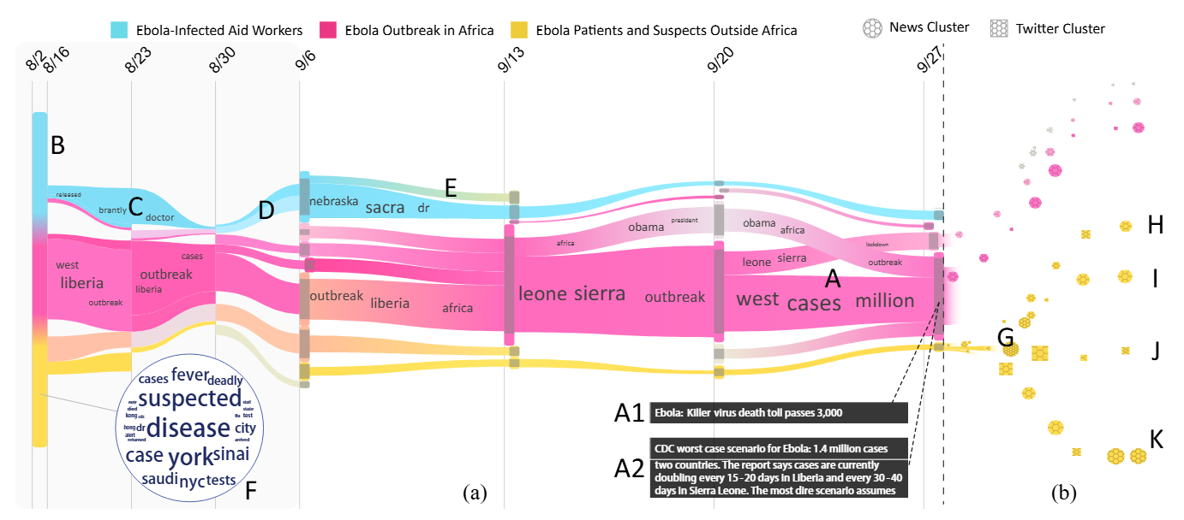
Understanding Dynamic Data Analysis Results
Online Analysis Example: TopicStream
Online Visual Analytics of Text Streams, doi: 10.1109/TVCG.2015.2509990.

Slide 77


Slide 78
XAI Method Families
Feature-Based Methods
  Which input features drove this decision? (SHAP, LIME)
Rule-Based Methods
  Express model logic as IF-THEN rules (Bayesian Rule Lists)
Propagation-Based Methods
  Trace information flow through layers (Grad-CAM, LRP, Integrated Gradients)
Case-Based Methods
  Find similar past examples and show how the model treated them (CBR)
Counterfactual Methods
  What minimal change would flip the decision? (DiCE)

Slide 79
Local vs. Global Explanations
Explaining Individual Predictions vs. Model Behaviour
Local explanations: focus on understanding a specific prediction.
Global explanations: aim to provide insights into the overall model logic and behaviour.

Slide 80
SHAP - What is it?
Developed by Lundberg & Lee (NeurIPS 2017)
  Based on Shapley values from cooperative game theory
  Each feature is treated as a player; the model output is the payout to distribute
SHAP assigns each feature a contribution score (SHAP value) for each prediction
  Positive value: feature pushes prediction above baseline
  Negative value: feature pushes prediction below baseline
Currently the most widely adopted XAI method in research and industry
  Provides both local (per-instance) and global (dataset-level) explanations

Slide 81
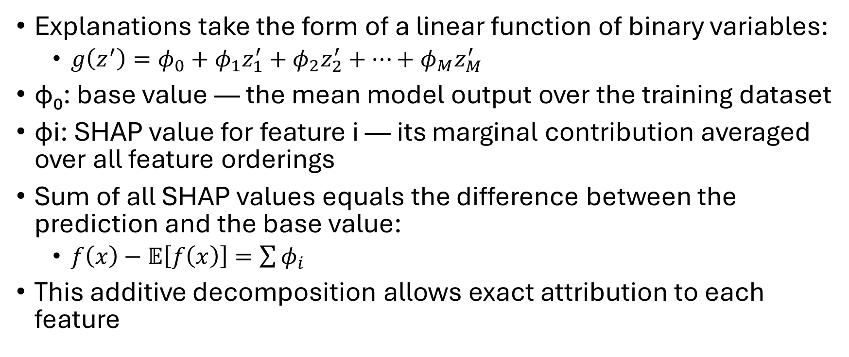
SHAP – Additive Feature Attribution
Explanations take the form of a linear function of binary variables:
  $g\left(z^{′}\right)=φ_{0}+φ_{1}z_{1}^{′}+φ_{2}z_{2}^{′}+⋯+φ_{M}z_{M}^{′}$
φ₀: base value — the mean model output over the training dataset
φi: SHAP value for feature i — its marginal contribution averaged over all feature orderings
Sum of all SHAP values equals the difference between the prediction and the base value:
  $f\left(x\right)−𝔼\left[f\left(x\right)\right]=\sum{φ_{i}}$
This additive decomposition allows exact attribution to each feature

Slide 82
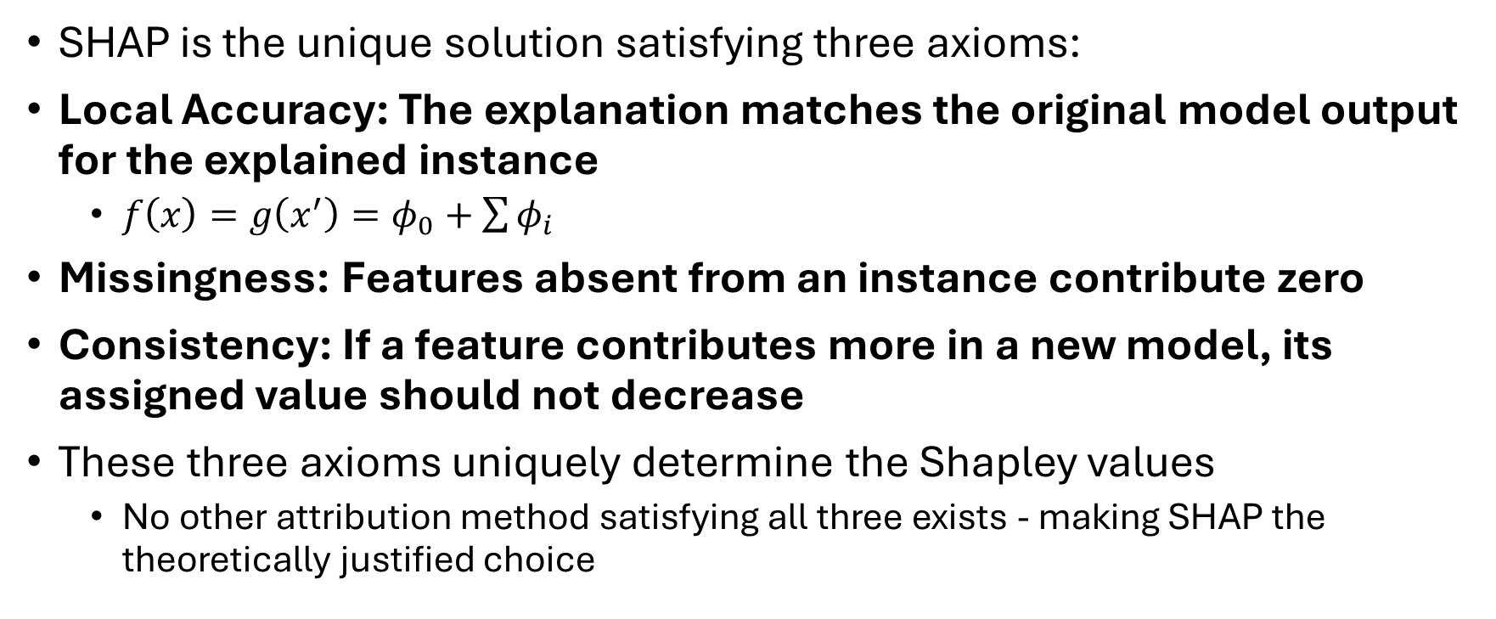
SHAP - Formal Properties
SHAP is the unique solution satisfying three axioms:
Local Accuracy: The explanation matches the original model output for the explained instance
  $f\left(x\right)=g\left(x^{′}\right)=φ_{0}+\sum{φ_{i}}$
Missingness: Features absent from an instance contribute zero
Consistency: If a feature contributes more in a new model, its assigned value should not decrease
These three axioms uniquely determine the Shapley values
  No other attribution method satisfying all three exists - making SHAP the theoretically justified choice

Slide 83
SHAP Variants
KernelSHAP
  Model-agnostic: works with any black-box model
  Samples feature coalitions, fits a weighted linear model locally
  Slower but applicable universally
TreeSHAP
  Optimised for tree-based models (Random Forest, XGBoost, LightGBM)
  Exact computation in polynomial time — fast and deterministic
DeepSHAP
  Adapted for deep neural networks; combines DeepLIFT with Shapley values
  Approximates contributions through the network's layers

Slide 84
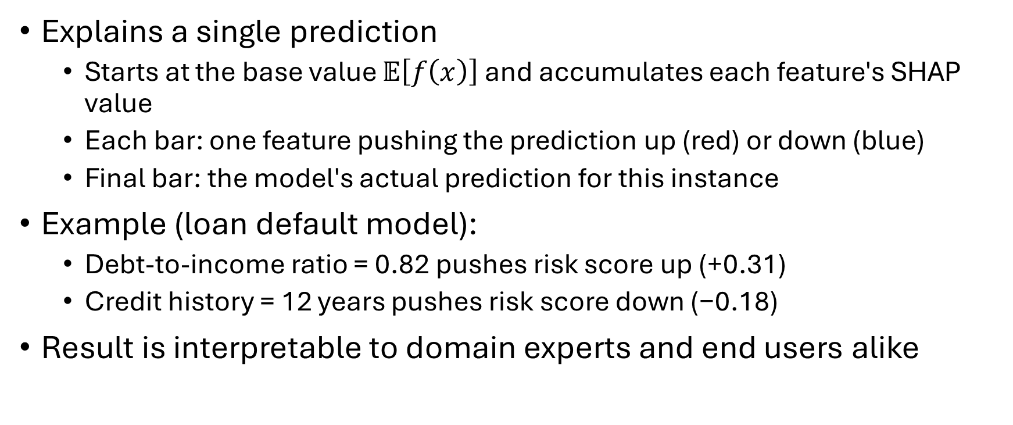
SHAP – Local Explanation: Waterfall Plot
Explains a single prediction
  Starts at the base value $𝔼\left[f\left(x\right)\right]$and accumulates each feature's SHAP value
  Each bar: one feature pushing the prediction up (red) or down (blue)
  Final bar: the model's actual prediction for this instance
Example (loan default model):
  Debt-to-income ratio = 0.82 pushes risk score up (+0.31)
  Credit history = 12 years pushes risk score down (−0.18)
Result is interpretable to domain experts and end users alike

Slide 85
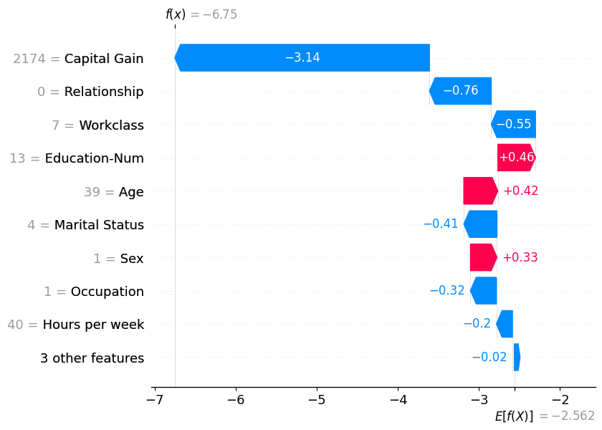

Slide 86
SHAP – Global Explanation: Beeswarm Plot
Aggregates SHAP values across all instances in the dataset
Each point = one instance; x-position = SHAP value; colour = feature value (high/low)
Features ranked top-to-bottom by mean absolute SHAP value
What the plot reveals:
  Which features matter most overall (ranking)
  Direction of influence: positive or negative effect on output
  Interaction patterns: e.g. high values of a feature always increase prediction
Enables model-level understanding without opening the black box

Slide 87
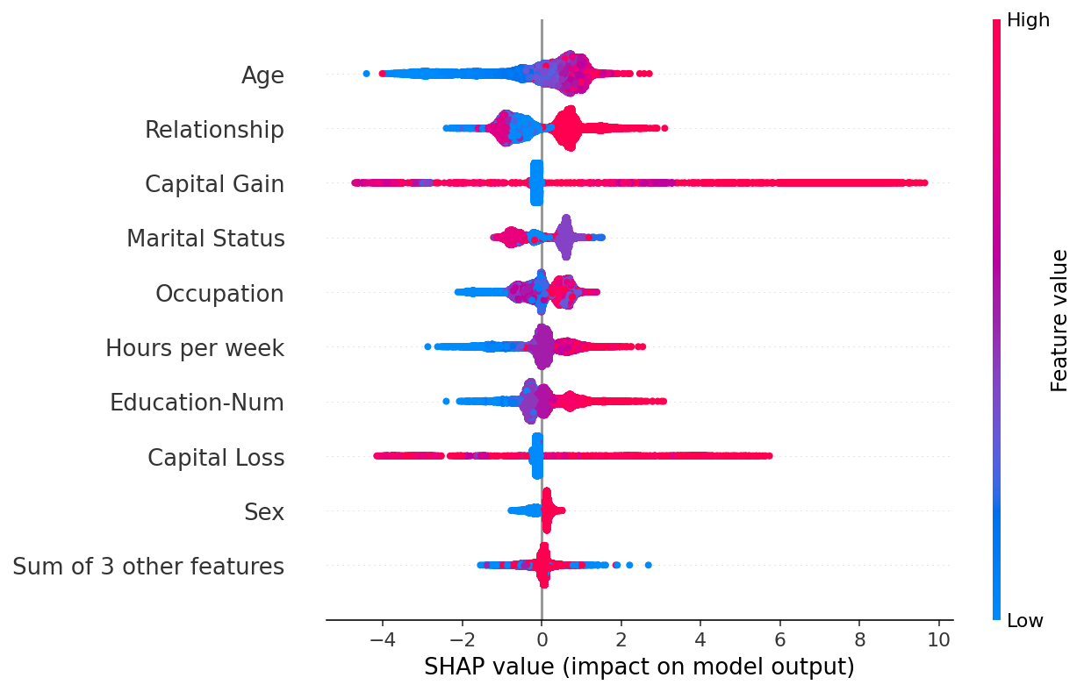

Slide 88
SHAP vs. LIME
Both explain individual predictions of any model (model-agnostic, local)
Theoretical foundation
  SHAP: game-theoretic Shapley values — unique and axiomatically justified
  LIME: local linear surrogate — no uniqueness guarantee
Scope of explanations
  SHAP: local AND global explanations in one framework
  LIME: local only
Stability
  SHAP (TreeSHAP): deterministic; KernelSHAP more stable than LIME
  LIME: can vary between runs due to random neighbourhood sampling
Non-linearity: SHAP captures feature interactions; LIME's linear surrogate cannot

Slide 89
Important Questions
[Homann]

Slide 90
Important Questions
[Homann]

Slide 91
Important Questions
[Homann]

Slide 92
Important Questions
[Homann]

Slide 93
Important Questions
[Homann]

Slide 94
Important Questions
[Homann]

Slide 95
Important Questions
[Homann]

Slide 96
XAI for Responsible AI
XAI is crucial for ensuring that AI is developed and used responsibly.
It promotes transparency, fairness, accountability, and ethical considerations in AI.

Slide 97
Recent Developments – EU AI Act
The EU AI Act entered into force in August 2024 — the world’s first comprehensive AI law
  Full compliance required by August 2026
For high-risk AI systems (hiring, credit, insurance, education, law enforcement):
  Article 13: Systems must be transparent enough for deployers to interpret output correctly
  Article 86: Individuals have a right to explanation of decisions affecting them
XAI methods like SHAP and LIME are now explicitly named as implementation strategies in regulatory guidance
The Act makes XAI a legal requirement, not just a best practice
Challenge: the Act defines explainability abstractly — no specific metric is mandated yet

Slide 98
Recent Developments – Faithfulness of Explanations
A growing concern: do post-hoc explanations actually reflect what the model is doing?
Adebayo et al. (2018) — “Sanity Checks for Saliency Maps”:
  Many saliency methods produce similar-looking maps even for randomly initialised networks
  Suggests some explanations reflect data structure, not the model’s learned function
A user trusting an explanation can be misled even when the explanation looks convincing
Open questions:
  Fidelity: does the explanation match the model’s actual reasoning?
  Stability: does the same input always yield the same explanation?
  Completeness: does the explanation capture all relevant factors?
Evaluation of XAI methods is now an active research area in itself

Slide 99
Recent Developments – Mechanistic Interpretability
A new paradigm: instead of post-hoc explanations, reverse-engineer what the network computes
Key findings (Anthropic, 2022–2024):
  Superposition: a single neuron encodes many concepts simultaneously
  Networks represent far more features than they have neurons, using sparse, near-orthogonal directions
  Sparse autoencoders (dictionary learning) can decompose activations into interpretable features
  Circuits: small subgraphs of neurons and attention heads implement specific algorithms
    Example: the induction head circuit implements in-context pattern matching in transformers
Qualitatively different from SHAP/LIME: aims for faithful, causal understanding of model internals
Currently limited to smaller models; scaling remains an open challenge

Slide 100
Recent Developments – LLMs and XAI
Large Language Models create two new roles for XAI:
1. Explaining LLMs (LLMs as the object of explanation)
  Classical XAI methods struggle: scale, emergent behaviour, and in-context learning break assumptions
  New approaches: chain-of-thought prompting as a built-in explanation, attention analysis, probing classifiers
2. LLMs as explanation generators (LLMs as a tool for XAI)
  LLMs can translate SHAP/LIME outputs into plain-language narratives accessible to non-experts
  Risk: LLM-generated explanations can hallucinate — plausible-sounding but unfaithful
Key open problem: how do we verify that a natural-language explanation is faithful to the model?

Slide 101
Future Development - Challenges
Scalability: classical XAI methods (KernelSHAP, LIME) are prohibitively slow on large foundation models
Faithfulness: no consensus on how to verify that an explanation reflects actual model reasoning
Evaluation: no standardised metrics for explanation quality across methods and domains
Regulation gap: EU AI Act mandates explainability for high-risk systems, but provides no technical specification of what qualifies
Multimodal models: explaining decisions that fuse text, image, and structured data simultaneously

Slide 102
Future Development - Opportunities
Concept-based explanations: human-defined concepts (TCAV, Concept Bottleneck Models) for domain experts who think in terms of concepts, not raw features
Mechanistic interpretability at scale: extending circuit-level analysis from small transformers to production-sized foundation models
LLMs as explanation interfaces: using language models to translate technical attribution scores into accessible narratives with faithfulness guarantees
Human-centred evaluation: moving beyond algorithmic metrics to user studies that test whether explanations actually help people make better decisions
Progressive visual analytics: interactive explanation interfaces that let domain experts refine and drill into model behaviour in real time

Slide 103
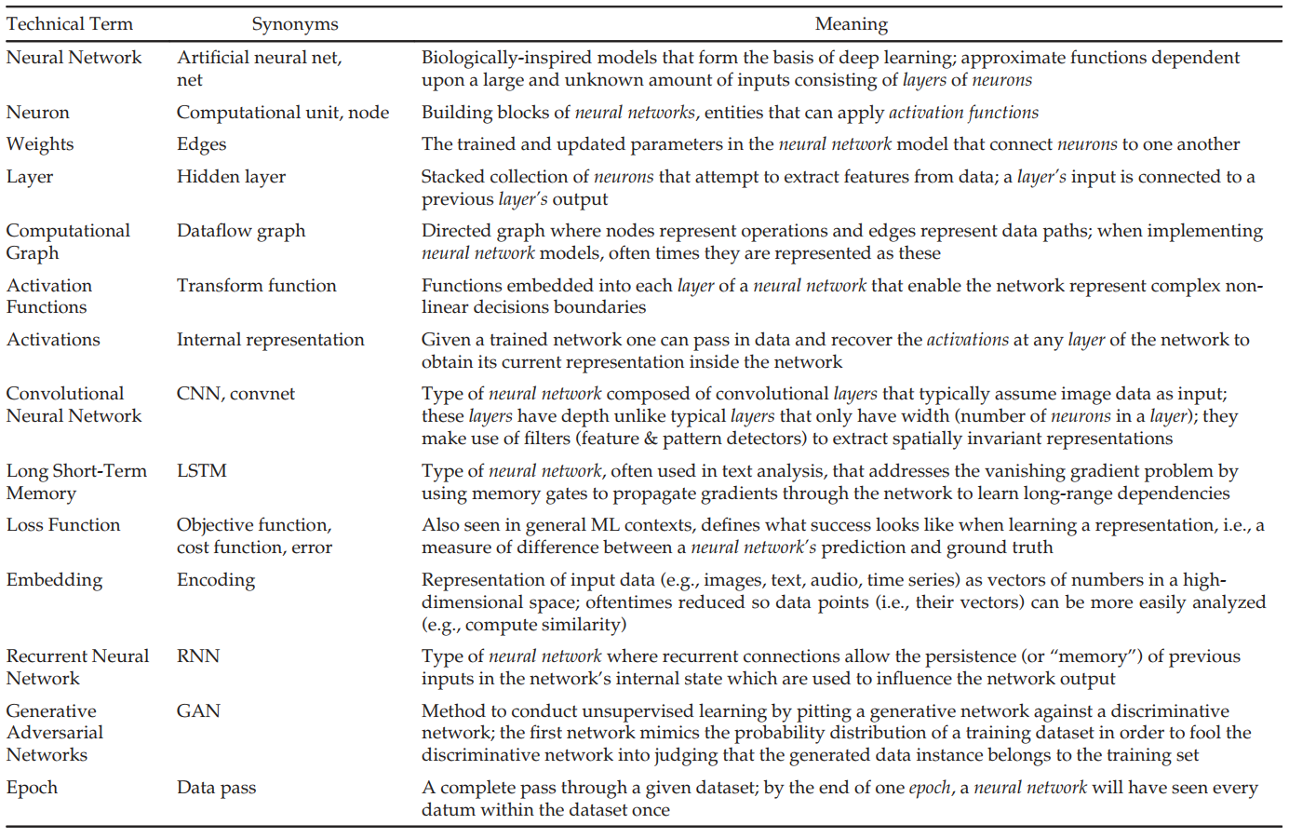
Homann

Slide 104
Sources
Adadi, A., & Berrada, M. (2018). Peeking Inside the Black-Box: A Survey on Explainable Artificial Intelligence (XAI). IEEE Access, 6. doi:10.1109/access.2018.2870052
Alicioglu, G., & Sun, B. (2022). A survey of visual analytics for Explainable Artificial Intelligence methods. Computers & Graphics, 102. doi:10.1016/j.cag.2021.09.002
Choo, J., & Liu, S. (2018). Visual Analytics for Explainable Deep Learning. arXiv. doi:10.48550/ARXIV.1804.02527
Dragoni, M., Donadello, I., & Eccher, C. (2020). Explainable AI meets persuasiveness: Translating reasoning results into behavioral change advice. Artificial Intelligence in Medicine, 105. doi:10.1016/j.artmed.2020.101840
Gunning, D., & Aha, D. W. (2019). DARPA's Explainable Artificial Intelligence Program. AI Magazine, 40. doi:10.1609/aimag.v40i2.2850
Hohman, F., Kahng, M., Pienta, R., & Chau, D. H. (2019). Visual Analytics in Deep Learning: An Interrogative Survey for the Next Frontiers. IEEE Transactions on Visualization and Computer Graphics, 25. doi:10.1109/tvcg.2018.2843369
La Rosa, B., et al. (2023). State of the Art of Visual Analytics for eXplainable Deep Learning. Computer Graphics Forum, 42. doi:10.1111/cgf.14733
Moradi, M., & Samwald, M. (2021). Post-hoc explanation of black-box classifiers using confident itemsets. Expert Systems with Applications, 165. doi:10.1016/j.eswa.2020.113941
Rai, A. (2019). Explainable AI: from black box to glass box. Journal of the Academy of Marketing Science, 48. doi:10.1007/s11747-019-00710-5
Yuan, J., et al. (2021). A survey of visual analytics techniques for machine learning. Computational Visual Media, 7. doi:10.1007/s41095-020-0191-7
Lundberg, S. M., & Lee, S.-I. (2017). A Unified Approach to Interpreting Model Predictions. Advances in Neural Information Processing Systems, 30. doi:10.48550/arXiv.1705.07874
Adebayo, J., et al. (2018). Sanity Checks for Saliency Maps. NeurIPS 2018. doi:10.48550/arXiv.1810.03292
Mothilal, R. K., Sharma, A., & Tan, C. (2020). Explaining Machine Learning Classifiers through Diverse Counterfactual Explanations. FAT* 2020. doi:10.1145/3351095.3372850

Slide 105
Sources
Templeton, A., et al. (2024). Scaling Monosemanticity: Extracting Interpretable Features from Claude 3 Sonnet. Transformer Circuits Thread. transformer-circuits.pub/2024/scaling-monosemanticity
European Parliament (2024). Regulation (EU) 2024/1689 - Artificial Intelligence Act. Official Journal of the European Union. eur-lex.europa.eu/legal-content/EN/TXT/?uri=OJ:L_202401689
Rauber et al. Visualizing the Hidden Activity of Artificial Neural Networks, doi: 10.1109/TVCG.2016.2598838.

